Slide 1
Isolation Forest , PCA , T-SNE , Kafka
- Varun Raste

Slide 2
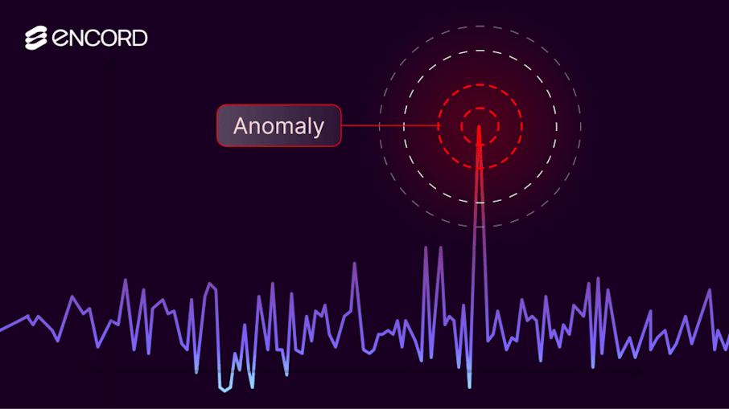
Anomaly Detection
Real-world data is noisy, high-dimensional, and imperfect.
Anomalies often represent fraud, system failures, or rare events.
High-dimensional data is hard to visualize and interpret.
Dimensionality reduction simplifies data without losing key patterns.
Together, these techniques improve detection, speed, and explainability.

Slide 3
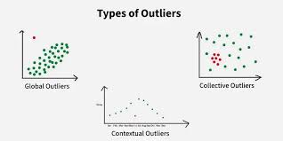
Outliers
Outliers are observations that deviate significantly from normal patterns.
They may occur due to errors, rare behavior, or genuine extreme events.
Not all outliers are noise; some carry high business value.
Detecting outliers requires understanding data distribution.
Context matters more than raw distance from the mean.
Point outliers are individual abnormal observations.
Contextual outliers depend on time or location context.
Collective outliers appear abnormal only as a group.
Different detection techniques handle different outlier types.
Choosing the wrong method can hide true anomalies

Slide 4
Outliers
Outliers are observations that deviate significantly from normal patterns.
They may occur due to errors, rare behavior, or genuine extreme events.
Not all outliers are noise; some carry high business value.
Detecting outliers requires understanding data distribution.
Context matters more than raw distance from the mean.
Point outliers are individual abnormal observations.
Contextual outliers depend on time or location context.
Collective outliers appear abnormal only as a group.
Different detection techniques handle different outlier types.
Choosing the wrong method can hide true anomalies

Slide 5
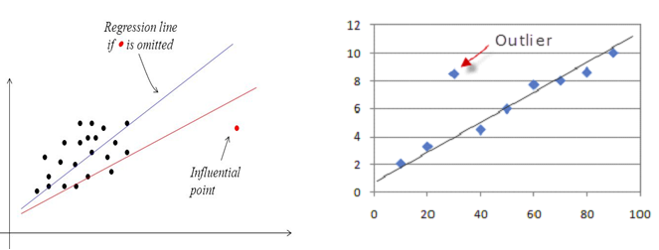
Outliers vs Influential Point
Aspect | Outlier | Influential Point
Definition | Extreme observation | Observation that affects model fit
Distance from data | Far from most points | May or may not be far
Effect on model | Sometimes minimal | Often significant
Detection | Z-score, IQR | Cook’s Distance, leverage
Treatment | Investigate or cap | Always investigate carefully
“A high-income customer in a luxury dataset is an outlier,
but a single wrong transaction that shifts the trend line is influential.”

Slide 6
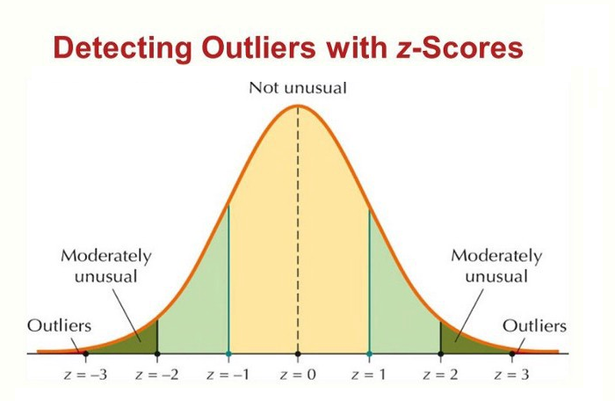
Outliers Detection Methods
Statistical methods assume data follows a known distribution.
Z-score flags points far from the mean.
IQR uses quartiles to detect extreme values.
These methods work well for low-dimensional data.
They fail when data is complex or non-linear.

Slide 7
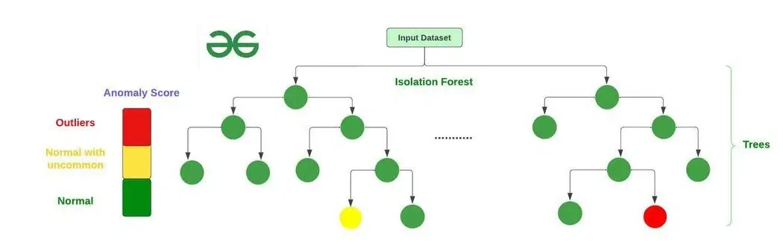
Isolation Forest
Isolation Forest is designed specifically for anomaly detection.
It isolates anomalies instead of profiling normal behavior.
Anomalies are easier to separate than normal points.
Works well with high-dimensional datasets.
Scales efficiently to large data volumes.
Random splits partition data recursively.
Anomalies get isolated in fewer splits.
Normal points require deeper trees to isolate.
Shorter path length indicates higher anomaly likelihood.
No distance or density assumptions required.

Slide 8
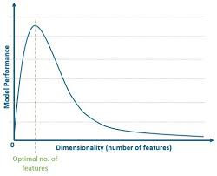
Curse of Dimensionality
High-dimensional data suffers from the curse of dimensionality.
Distance metrics lose meaning as dimensions increase.
Visualization becomes impossible beyond 3 dimensions.
Dimensionality reduction preserves structure while simplifying data.
Used for visualization, noise reduction, and preprocessing.

Slide 9
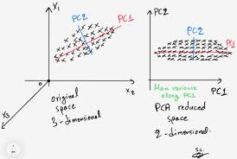
PCA
PCA is a linear dimensionality reduction technique.
It transforms features into orthogonal components.
Components capture maximum variance in the data.
Reduces redundancy caused by correlated features.
Often used as a preprocessing step.
PCA finds directions with maximum data spread.
First component captures highest variance.
Subsequent components capture remaining variance.
Components are uncorrelated with each other.
Fewer components retain most information.

Slide 10
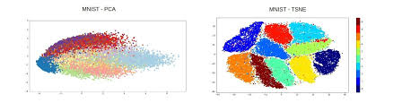
T-SNE
t-SNE is a non-linear dimensionality reduction technique.
Primarily used for visualization in 2D or 3D.
Preserves local neighborhood relationships.
Reveals hidden cluster structures.
Not designed for downstream modeling.
PCA focuses on global variance.
t-SNE focuses on local similarity.
PCA is deterministic and stable.
t-SNE is stochastic and parameter-sensitive.
PCA scales better to large datasets..

Slide 11
PCA vs t-SNE
Aspect | PCA (Principal Component Analysis) | t-SNE (t-Distributed Stochastic Neighbor Embedding)
Type | Linear dimensionality reduction | Non-linear dimensionality reduction
Primary Goal | Preserve maximum variance | Preserve local neighborhood structure
Output Stability | Deterministic and reproducible | Stochastic; varies across runs
Interpretability | Components are interpretable | Embeddings are not interpretable
Scalability | Fast and scalable | Computationally expensive
Use in Pipelines | Yes, usable for modeling | No, visualization only
Sensitivity to Scaling | Highly sensitive | Moderately sensitive
Best Use Case | Feature reduction, preprocessing | Data exploration, cluster visualization

Slide 12
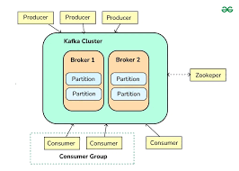
Kafka Concept
Kafka is a distributed event-streaming platform.
Designed for high-throughput, fault-tolerant systems.
Producers publish events to topics.
Consumers subscribe and process events.
Kafka acts as a real-time data backbone.
Topics store streams of events.
Partitions enable parallelism.
Offsets track event positions.
Brokers manage message storage.
Consumer groups allow scalable consumption.

Slide 13
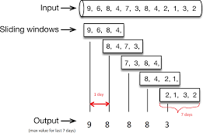
Sliding Window Concept
Sliding windows move continuously over time.
Each event can belong to multiple windows.
Captures evolving trends smoothly.
Useful for anomaly detection and monitoring.
More computationally expensive than fixed windows.
Fraud detection over recent transactions.
Monitoring system metrics in real time.
Detecting spikes or drops in activity.
Streaming anomaly detection pipelines.
Alerting systems with low latency.

